Slide 1
Announcements
This is to remind you that course evaluations for the spring 2015 semester have started and that you can now view the response rates for your classes in real time at
Notes:
The University of Adelaide, School of Computer Science
Chapter 2 — Instructions: Language of the Computer

Slide 2
Today’s Agenda
  Pop Quiz
  Previous class review (refresher)
      HTTP
      Papers
    Today’s Class
      Paper discussion and review
        Load Balancing
        Timing Attacks on SSL
        Adoption of IP 6

Slide 3
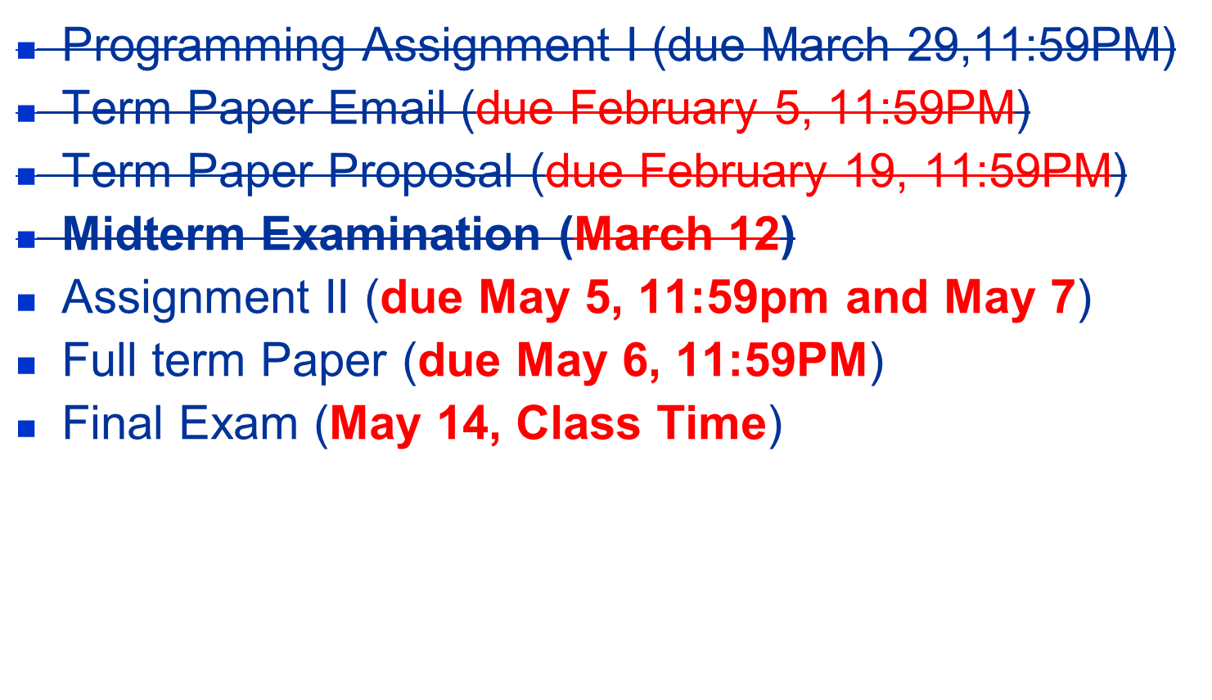
Due Dates
Notes:
The University of Adelaide, School of Computer Science
Chapter 2 — Instructions: Language of the Computer

Slide 4
Previous Class

Slide 5
World Wide Web
  The World Wide Web has been so successful and has made the Internet accessible to so many people that sometimes it seems to be synonymous with the Internet.
  In fact, the design of the system that became the Web started around 1989, long after the Internet had become a widely deployed system.
  The original goal of the Web was to find a way to organize and retrieve information, drawing on ideas about hypertext—interlinked documents—that had been around since at least the 1960s.
Notes:
The University of Adelaide, School of Computer Science
Chapter 2 — Instructions: Language of the Computer

Slide 6
World Wide Web
  The core idea of hypertext is that one document can link to another document, and the protocol (HTTP) and document language (HTML) were designed to meet that goal.
  One helpful way to think of the Web is as a set of cooperating clients and servers, all of whom speak the same language: HTTP.
  Most people are exposed to the Web through a graphical client program, or Web browser, like Safari, Chrome, Firefox or Internet Explorer.
Notes:
The University of Adelaide, School of Computer Science
Chapter 2 — Instructions: Language of the Computer

Slide 7
World Wide Web
  Clearly, if you want to organize information into a system of linked documents or objects, you need to be able to retrieve one document to get started.
  Hence, any Web browser has a function that allows the user to obtain an object by “opening a URL.”
  URLs (Uniform Resource Locators) are so familiar to most of us by now that it’s easy to forget that they haven’t been around forever.
  They provide information that allows objects on the Web to be located, and they look like the following:
    http://www.cs.princeton.edu/index.html
Notes:
The University of Adelaide, School of Computer Science
Chapter 2 — Instructions: Language of the Computer

Slide 8
World Wide Web
  If you opened that particular URL, your Web browser would open a TCP connection to the Web server at a machine called www.cs.princeton.edu and immediately retrieve and display the file called index.html.
  Most files on the Web contain images and text and many have other objects such as audio and video clips, pieces of code, etc.
  They also frequently include URLs that point to other files that may be located on other machines, which is the core of the “hypertext” part of HTTP and HTML.
Notes:
The University of Adelaide, School of Computer Science
Chapter 2 — Instructions: Language of the Computer

Slide 9
World Wide Web
  When you ask your browser to view a page, your browser (the client) fetches the page from the server using HTTP running over TCP.
  HTTP is a text oriented protocol.
  At its core, HTTP is a request/response protocol, where every message has the general form
  START_LINE <CRLF>
  MESSAGE_HEADER <CRLF>
  <CRLF>
  MESSAGE_BODY <CRLF>
  where as before,<CRLF>stands for carriage-return-line-feed.The first line (START LINE)
  indicates whether this is a request message or a response message.
Notes:
The University of Adelaide, School of Computer Science
Chapter 2 — Instructions: Language of the Computer

Slide 10
World Wide Web
  Request Messages
    The first line of an HTTP request message specifies three things: the operation to be performed, the Web page the operation should be performed on, and the version of HTTP being used.
    Although HTTP defines a wide assortment of possible request operations—including “write” operations that allow a Web page to be posted on a server—the two most common operations are GET (fetch the specified Web page) and HEAD (fetch status information about the specified Web page).
Notes:
The University of Adelaide, School of Computer Science
Chapter 2 — Instructions: Language of the Computer

Slide 11
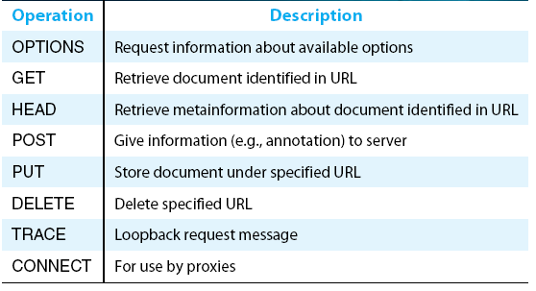
World Wide Web
  Request Messages
HTTP request operations
Notes:
The University of Adelaide, School of Computer Science
Chapter 2 — Instructions: Language of the Computer

Slide 12
World Wide Web
  Response Messages
    Like request messages, response messages begin with a single START LINE.
    In this case, the line specifies the version of HTTP being used, a three-digit code indicating whether or not the request was successful, and a text string giving the reason for the response.
Notes:
The University of Adelaide, School of Computer Science
Chapter 2 — Instructions: Language of the Computer

Slide 13
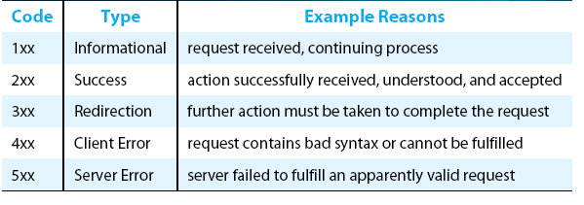
World Wide Web
  Response Messages
Five types of HTTP result codes
Notes:
The University of Adelaide, School of Computer Science
Chapter 2 — Instructions: Language of the Computer

Slide 14
World Wide Web
  Uniform Resource Identifiers
    The URLs that HTTP uses as addresses are one type of Uniform Resource Identifier (URI).
    A URI is a character string that identifies a resource, where a resource can be anything that has identity, such as a document, an image, or a service.
    The format of URIs allows various more-specialized kinds of resource identifiers to be incorporated into the URI space of identifiers.
    The first part of a URI is a scheme that names a particular way of identifying a certain kind of resource, such as mailto for email addresses or file for file names.
    The second part of a URI, separated from the first part by a colon, is the scheme-specific part.
Notes:
The University of Adelaide, School of Computer Science
Chapter 2 — Instructions: Language of the Computer

Slide 15
World Wide Web
  TCP Connections
    The original version of HTTP (1.0) established a separate TCP connection for each data item retrieved from the server.
    It’s not too hard to see how this was a very inefficient mechanism: connection setup and teardown messages had to be exchanged between the client and server even if all the client wanted to do was verify that it had the most recent copy of a page.
    Thus, retrieving a page that included some text and a dozen icons or other small graphics would result in 13 separate TCP connections being established and closed.
Notes:
The University of Adelaide, School of Computer Science
Chapter 2 — Instructions: Language of the Computer

Slide 16
World Wide Web
  TCP Connections
    To overcome this situation, HTTP version 1.1 introduced persistent connections— the client and server can exchange multiple request/response messages over the same TCP connection.
    Persistent connections have many advantages.
      First, they obviously eliminate the connection setup overhead, thereby reducing the load on the server, the load on the network caused by the additional TCP packets, and the delay perceived by the user.
      Second, because a client can send multiple request messages down a single TCP connection, TCP’s congestion window mechanism is able to operate more efficiently.
        This is because it’s not necessary to go through the slow start phase for each page.
Notes:
The University of Adelaide, School of Computer Science
Chapter 2 — Instructions: Language of the Computer

Slide 17
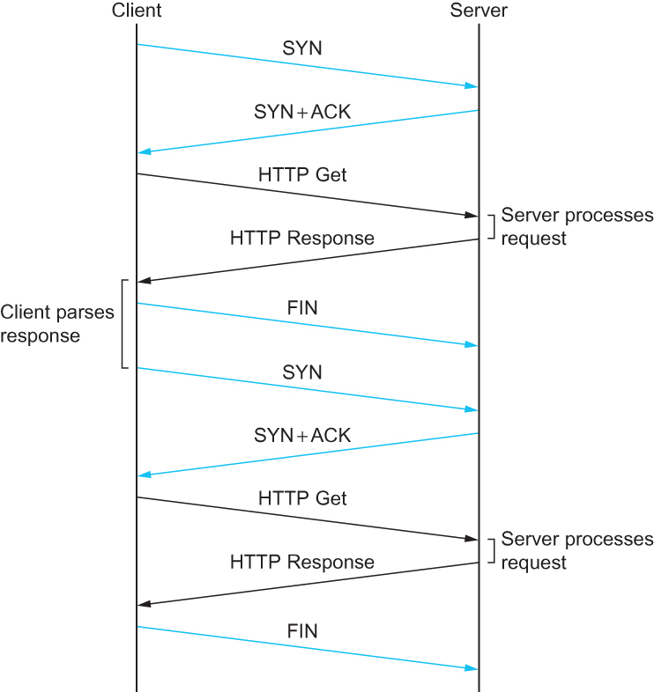
World Wide Web
  TCP Connections
HTTP 1.0 behavior
Notes:
The University of Adelaide, School of Computer Science
Chapter 2 — Instructions: Language of the Computer

Slide 18
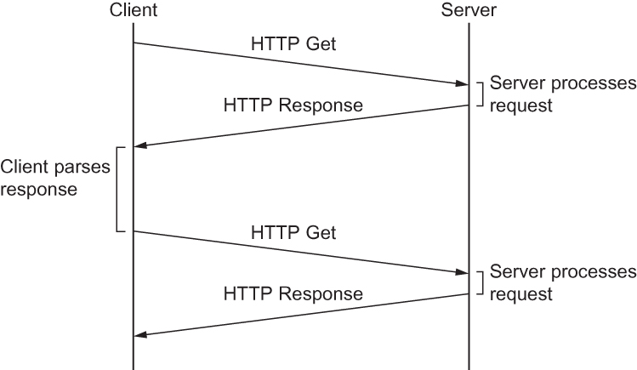
World Wide Web
  TCP Connections
HTTP 1.1 behavior with persistent connections
Notes:
The University of Adelaide, School of Computer Science
Chapter 2 — Instructions: Language of the Computer

Slide 19
World Wide Web
  Caching
    One of the most active areas of research (and entrepreneurship) in the Internet today is how to effectively cache Web pages.
    Caching has many benefits. From the client’s perspective, a page that can be retrieved from a nearby cache can be displayed much more quickly than if it has to be fetched from across the world.
    From the server’s perspective, having a cache intercept and satisfy a request reduces the load on the server.
Notes:
The University of Adelaide, School of Computer Science
Chapter 2 — Instructions: Language of the Computer

Slide 20
World Wide Web
  Caching
    Caching can be implemented in many different places. For example, a user’s browser can cache recently accessed pages, and simply display the cached copy if the user visits the same page again.
    As another example, a site can support a single site-wide cache.
    This allows users to take advantage of pages previously downloaded by other users.
    Closer to the middle of the Internet, ISPs can cache pages.
    Note that in the second case, the users within the site most likely know what machine is caching pages on behalf of the site, and they configure their browsers to connect directly to the caching host. This node is sometimes called a proxy
Notes:
The University of Adelaide, School of Computer Science
Chapter 2 — Instructions: Language of the Computer

Slide 21
Papers [Last Class]
Neural Network Clustering of Web Users
Dominating Characteristics of Internet
Notes:
The University of Adelaide, School of Computer Science
Chapter 2 — Instructions: Language of the Computer

Slide 22
Papers [Today’s Class]
Load Balancing
Adoption of IP 6
Timing Attacks on SSL
Notes:
The University of Adelaide, School of Computer Science
Chapter 2 — Instructions: Language of the Computer

